Slide 1
Data Structures and Algorithms -3 (25CS2103E)
STUDENT DOCUMENT SIMILARITY ANALYSIS
Team Members
J. SIMRAN - 2520030166
K. ANUSRI - 2520030432
S. RIKHIL - 2520030480
Under the Esteemed Guidance of
Dr. S Madhavi
CSE

Slide 2
Contents
Abstract
Introduction
Literature survey
Problem Statement and Objectives
Hardware and Software requirements
Results
Conclusion
Future Scope

Slide 3
Abstract
The project is a Student Document Similarity Analysis system that uses the Z-Algorithm to identify similar content between multiple documents.
The system reads a collection of documents from a corpus and processes their text into meaningful sentence chunks.
It compares every possible pair of documents, calculates their similarity percentage, and displays the similar document pairs from highest to lowest similarity. The system helps in identifying documents that contain a significant amount of common or duplicated content.

Slide 4
Introduction
A large number of student documents can be difficult to compare manually, especially when dealing with a large collection. Students may submit documents containing copied or repeated content, making it necessary to identify similar documents efficiently. Checking every document against all other documents manually requires considerable time and effort. Our system automatically processes a collection of documents from a corpus, converts the text into lowercase, and divides it into meaningful sentence chunks. Every possible pair of documents is compared using the Z-Algorithm, and a similarity percentage is calculated for each relevant pair. The results are then sorted from highest similarity to lowest similarity, making it easier to identify documents containing significant common or duplicated content.

Slide 5
Literature Survey
1. Plagiarism Detection in the Digital Era (2024)
Reviewed modern plagiarism detection methods and emphasized the need for automated, reliable, and efficient document comparison systems.
2. T-SRE: Transformer-based Semantic Relation Extraction (2024)
Used transformer-based analysis to detect paraphrased plagiarism and semantic similarities that may be missed by traditional text matching techniques.
3. Plagiarism Detection Using Machine Learning (2024)
Explored NLP and machine-learning techniques for detecting exact and paraphrased plagiarism with improved accuracy and better scalability.
4. Comparative Analysis of Text-Based Plagiarism Detection Techniques(2025)
Compared text-based plagiarism detection methods and discussed techniques for improving similarity detection.
Research Gap / Our Approach
Recent methods focus on NLP, machine learning, and semantic analysis. Our project uses the Z-Algorithm for exact text matching, compares multiple documents, and calculates and ranks similarity percentages to identify highly similar document pairs.

Slide 6
Problem Statement and Objectives
PROBLEM STATEMENT:
When a large number of student documents are submitted, manually comparing every document with the others is time-consuming. Some documents may contain copied or repeated content with only minor changes. Therefore, an automated system is needed to compare multiple documents, identify similar document pairs, and calculate their similarity percentage.
OBJECTIVES:
Process multiple documents from a corpus.- Pre-process the text and divide it into meaningful chunks.- Compare every possible pair of documents.- Use the Z-Algorithm for exact substring matching.- Calculate the similarity percentage between document pairs.- Display similar document pairs in descending order of similarity.

Slide 7
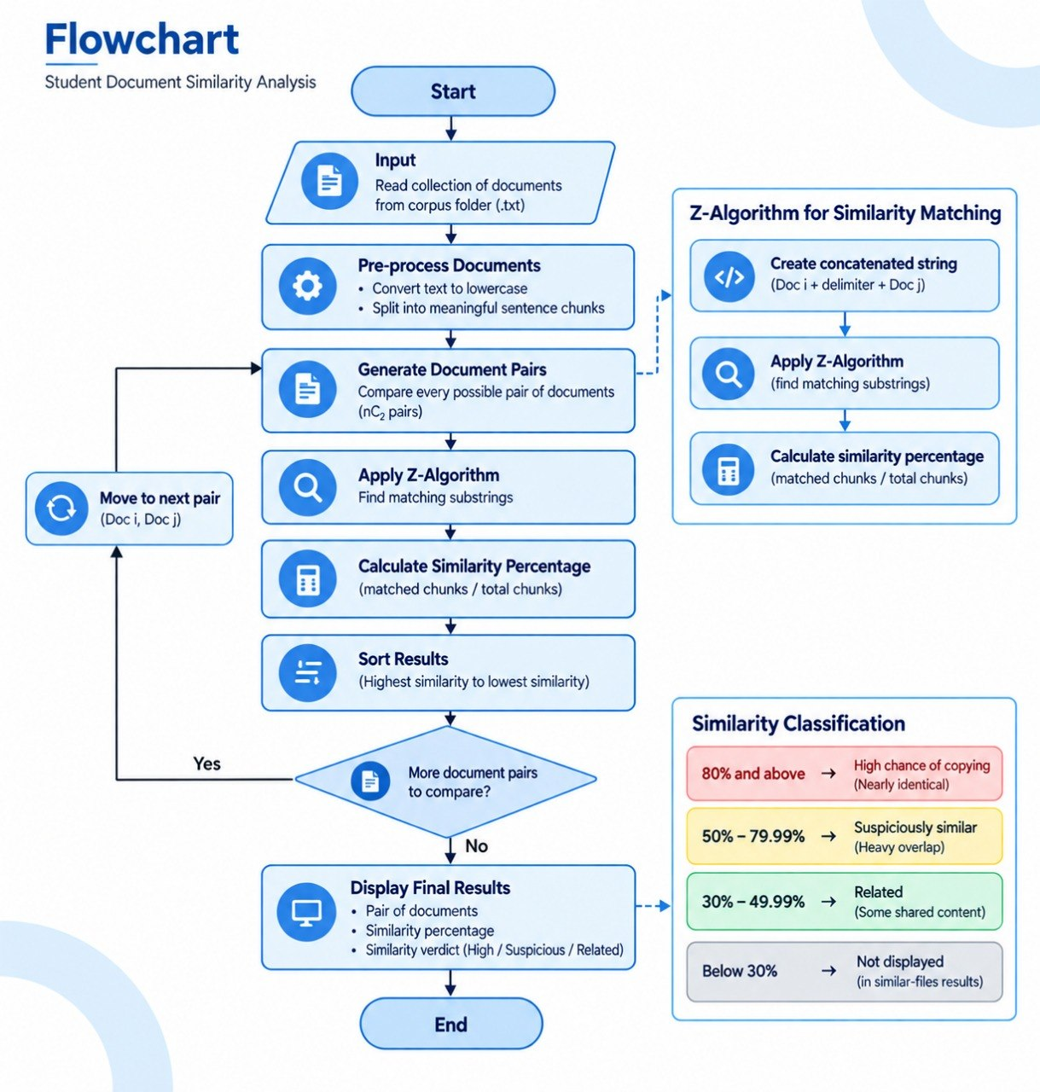
Flow Chart

Slide 8
Results
The system produces similarity results for the documents in the corpus. For each similar document pair, the output displays:
Pair of Documents
Similarity Percentage
Similarity Verdict
The results are arranged from highest similarity to lowest similarity.
SIMILARITY CLASSIFICATION:
80% and above:
HIGH CHANCE OF COPYING - Nearly identical
50% - 79.99%:
SUSPICIOUSLY SIMILAR - Heavy overlap
30% - 49.99%:
RELATED - Some shared content
Below 30%:
Not displayed in the similar-files results

Slide 9
Hardware and Software requirements
HARDWARE REQUIREMENTS | SOFTWARE REQUIREMENTS
Computer / Laptop | Operating System: Windows / Linux
Minimum 4 GB RAM | Programming Language: Java
Keyboard and Mouse | Java I/O and NIO File Handling
Storage for Document Corpus | Code Editor / IDE
TECHNOLOGIES USED:
1. Z-Algorithm: Used for exact substring matching.
2. Text Pre-processing: Converts document text to lowercase and divides it into meaningful sentence chunks.
3. File Handling: Reads .txt files from the corpus folder.
4. Document Pair Comparison: Compares every possible pair of documents.
5. Similarity Calculation: Calculates the percentage of matched chunks.
6. Result Sorting: Arranges similar document pairs from highest to lowest similarity.

Slide 10
Conclusion
The project provides an automated approach for analyzing similarity between multiple documents.
Documents are pre-processed before comparison.
Every possible pair of documents is compared.
The Z-Algorithm is used for exact substring matching.
A similarity percentage is calculated for each document pair.
Similar document pairs are filtered using a minimum similarity threshold
The results are sorted and displayed from highest to lowest similarity.
The system reduces the effort required for manually checking large numbers of documents.

Slide 11
Future Scope
No. | Future Enhancement | Description
1 | PDF & DOCX Support | Support PDF and DOCX files directly.
2 | Large-Scale Comparison | Compare a larger number of documents efficiently.
3 | Graphical User Interface | Add a user-friendly GUI for easier interaction.
4 | Match Highlighting | Highlight exact matching portions of documents.
5 | Similarity Reports | Generate detailed similarity reports.
6 | Paraphrase Detection | Improve detection of modified and paraphrased content.
7 | Document Storage | Store previous documents for future comparison.
8 | Advanced Similarity Techniques | Add more advanced text similarity methods.

Slide 12
Thank you

